Slide 1
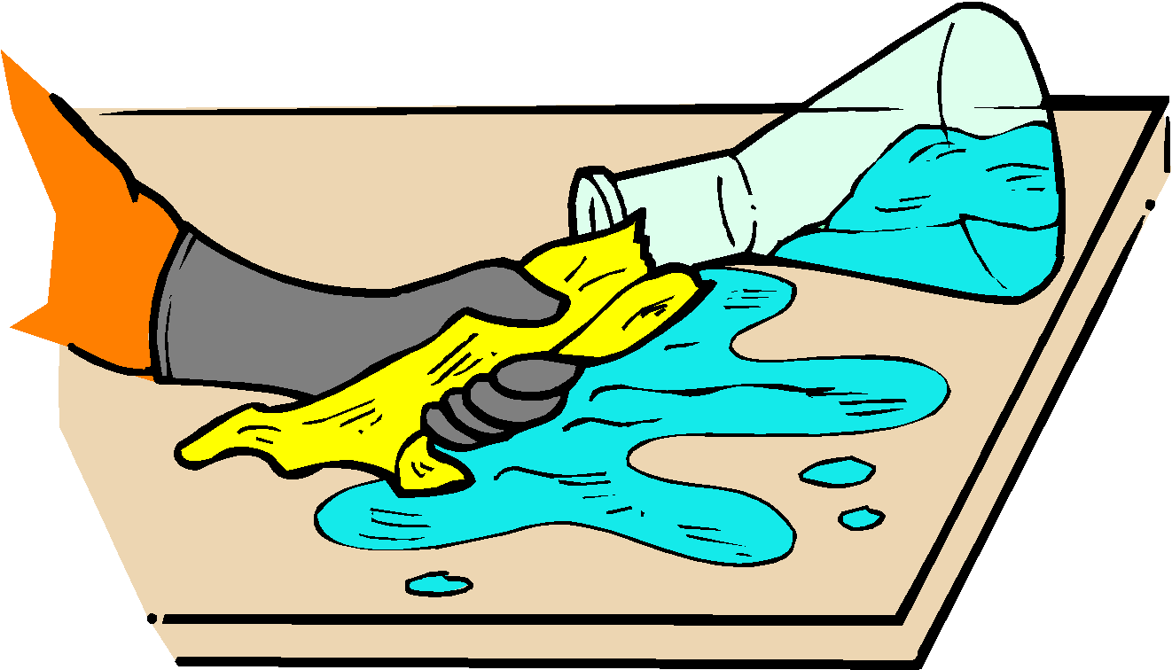
A. General Safety Rules
1. Listen to or read instructions carefully before attempting to do anything.
2. Wear safety goggles to protect your eyes from chemicals, heated materials, or things that might be able to shatter.
3. Notify your teacher if any spills or accidents occur.

Slide 2
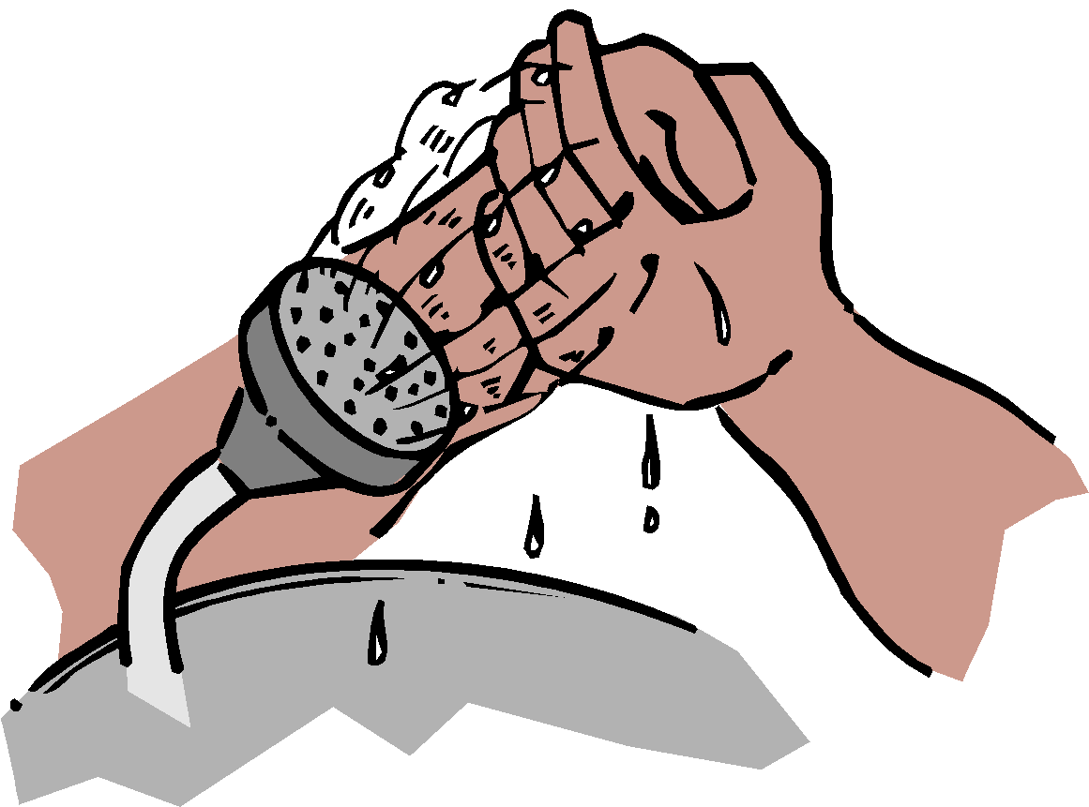
A. General Safety Rules
4. After handling chemicals, always wash your hands with soap and water.
5. During lab work, keep your hands away from your face.
6. Tie back long hair.

Slide 3
A. General Safety Rules
7. Roll up loose sleeves.
8. Know the location of the fire extinguisher, fire blanket, eyewash station, and first aid kit.
9. Keep your work area uncluttered. Take to the lab station only what is necessary.

Slide 4
A. General Safety Rules
10. It is suggested that you wear glasses rather than contact lenses.
11. Never put anything into your mouth during a lab experiment.
12. Clean up your lab area at the conclusion of the laboratory period.
13. Never “horse around” or play practical jokes in the laboratory.

Slide 5
B. Glassware Safety
1. Chipped or cracked glassware should not be used. Show it to the teacher.
2. Broken glassware should not be disposed of in a classroom trashcan. There is a special glass disposal container for it.
3. When pouring liquids into glassware, make sure the container you are pouring into is resting on a table at least a 20 cm from the edge.

Slide 6
B. Glassware Safety
If a piece of glassware gets broken, do not try to clean it up by yourself. Notify the teacher.
Do not place hot glassware in water. Rapid cooling may make it shatter.

Slide 7
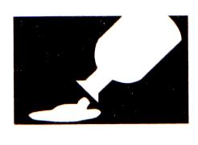
C. Chemical Safety
1. Wear protective goggles and a lab apron whenever heating or pouring hazardous chemicals.
2. Never mix chemicals together unless you are told to do so (and then only in the manner specified).
3. Never taste any chemicals (you should never taste anything in the lab).

Slide 8
C. Chemical Safety
4. If you need to smell the odor of a chemical, waft the fumes toward your nose with one hand. Do not put your nose over the container and inhale the fumes.
5. Never pour water into a concentrated acid. Acid should be poured slowly into water.

Slide 9
C. Chemical Safety
6. Follow the instructions of your teacher when disposing of all chemicals.
7. Wash your hands after handling hazardous chemicals.

Slide 10
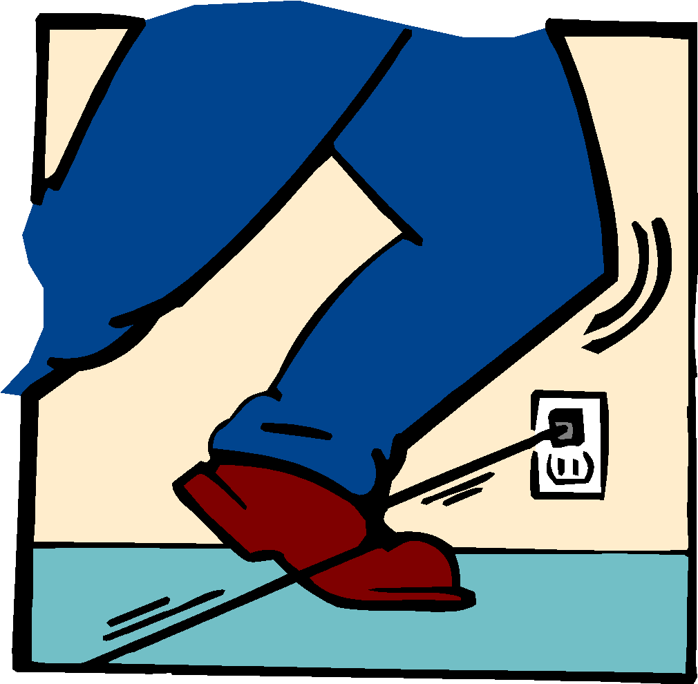
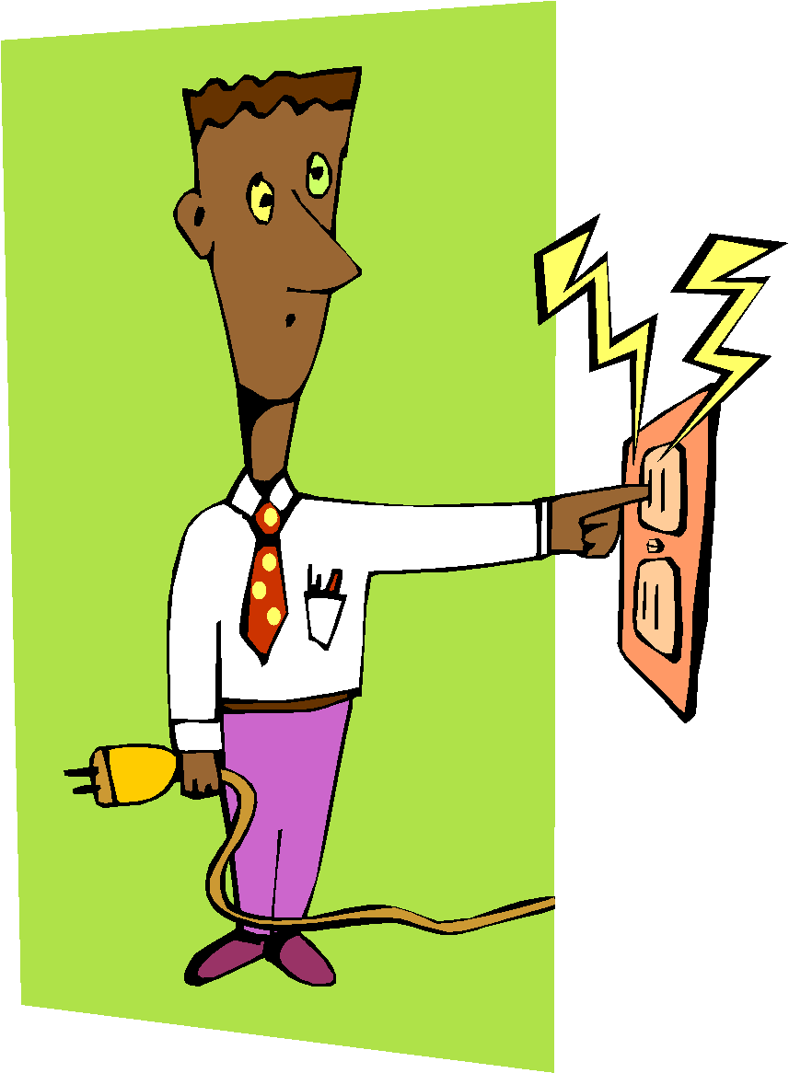
D. Electrical Safety
1. Lay electrical cords where no one can trip on them or get caught in them.
2. Be sure your hands and your lab area are dry before using electrical equipment.
3. Never poke anything into electrical outlets.

Slide 11
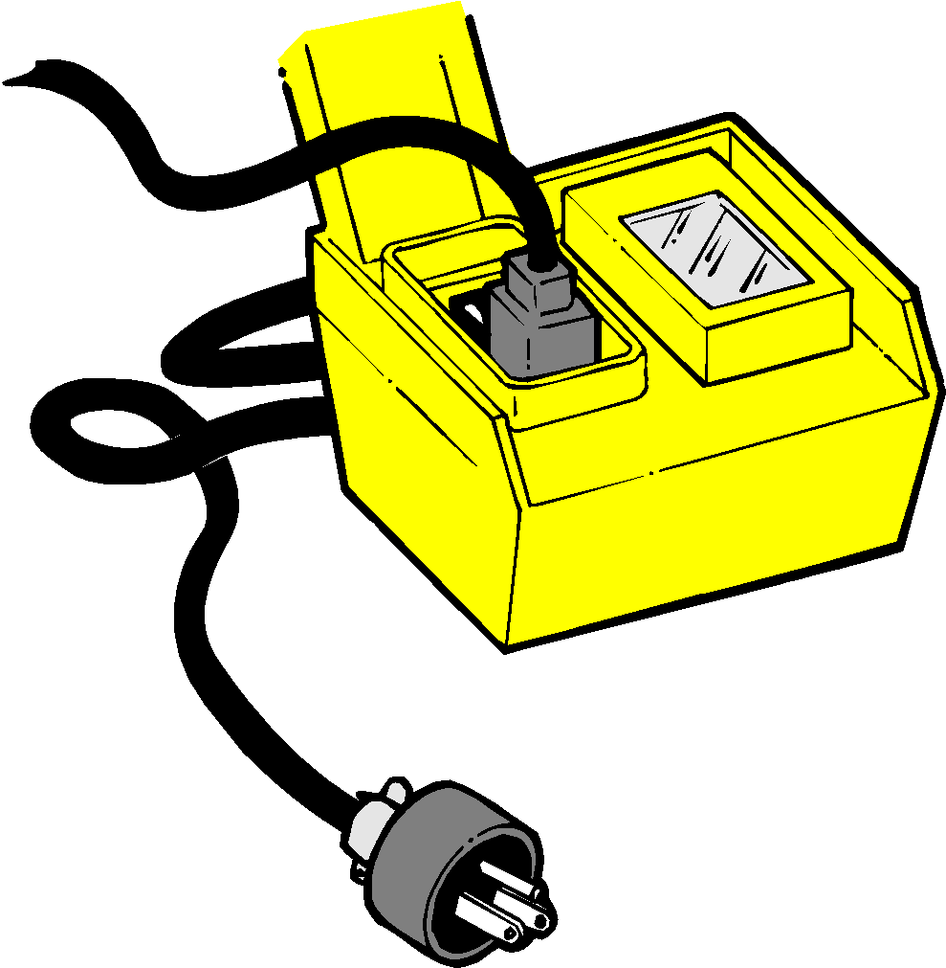
D. Electrical Safety
4. Unplug cords by pulling the plug and not the cord.
5. Unplug all electrical equipment at the end of the lab period.

Slide 12
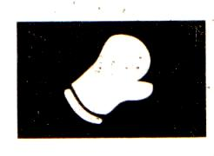
E. Heating Safety
1. Let burners and hotplates cool down before touching them. Test to see if they are cool enough by bringing the back of your hand close to them.
2. Use tongs and/or protective gloves to handle hot objects.
3. Never reach across an open flame or burner.

Slide 13
E. Heating Safety
4. The only type of glassware that may safely be heated is either Kimax or Pyrex.
5. Always point the top ends of test tubes that are being heated away from people.
6. When heating a test tube, move it around slowly over the flame to distribute the heat evenly.

Slide 14
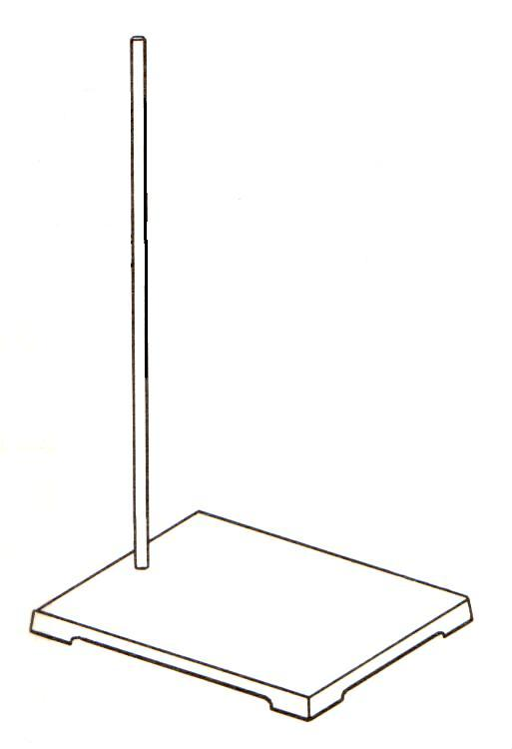
E. Heating Safety
7. Only glassware that is thoroughly dry should be heated.
8. Heat glassware by placing it on a wire gauze platform on a ringstand. Do not hold it in your hand.

Slide 15
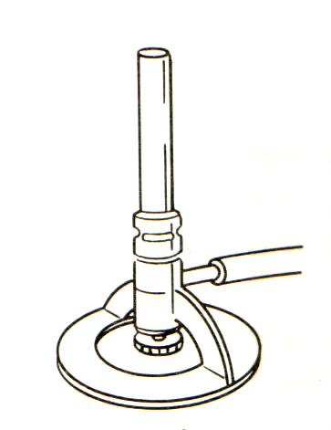
E. Heating Safety
9. When lighting a burner, wait until a match is struck or the striker is in place before you turn on the gas.
10. The amount of air can be adjusted by the air supply valve below the tube of the burner. This regulates the flame temperature and color.
11. Never leave a burner or hotplate unattended.

Slide 16
First Aid
Injury: Burns
To do: Immediately flush with cold water until burning sensation is lessened.

Slide 17
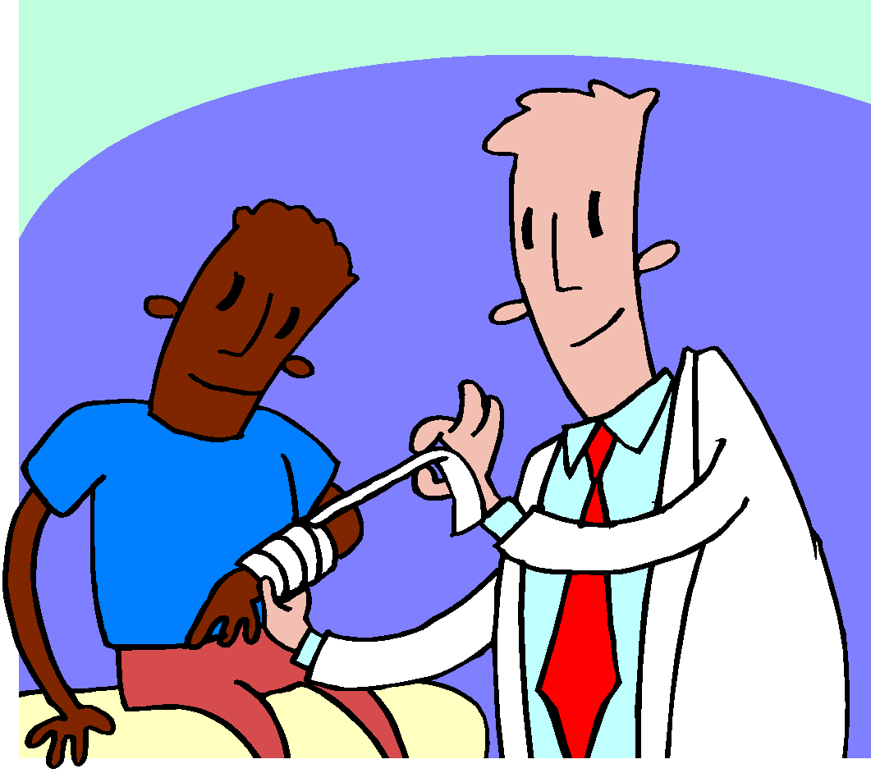
First Aid
Injury: Cuts, bruises
To do: Do not touch an open wound without safety gloves. Pressing directly on minor cuts will stop bleeding in a few minutes. Apply cold compress to bruises to reduce swelling.

Slide 18
First Aid
Injury: Fainting
To do: Provide fresh air and have the person recline so that their head is lower than the rest of their body.

Slide 19
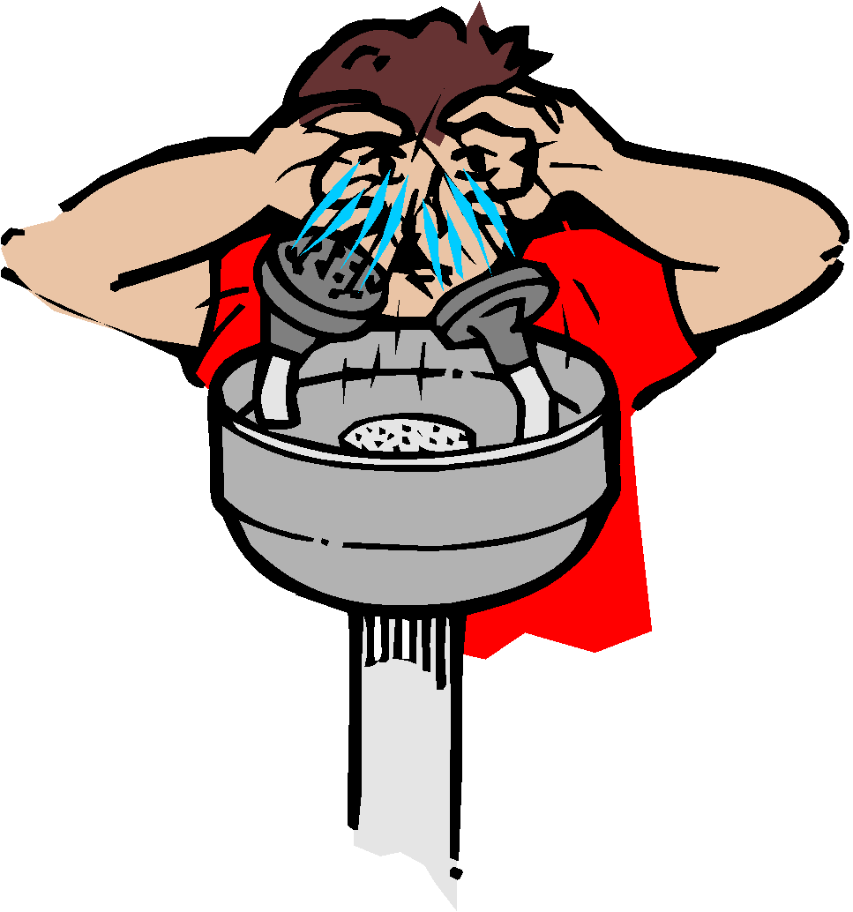
First Aid
Injury: The eyes
To do: Flush eyes immediately with plenty of water for several minutes. If a foreign object is lodged in the eye, do not allow the eye to be rubbed.

Slide 20
First Aid
Injury: Poisoning
To do: Find out what substance was responsible for the poisoning and alert the teacher immediately.

Slide 21
First Aid
Injury: Spills on the skin
To do: Flush with large quantities of water. For acid spills apply baking soda solution. For base spills apply vinegar or boric acid.

